Slide 1
Guns – Transfer of Ownership and Other Firearms Related Issues Encountered by Estate Planning Professionals
Nickolaus E. Buchholz, Esq.
Lester & Cantrell, LLP

Slide 2
A Few Statistics
There are an estimated 310 million guns in the hand of private citizens in the U.S.
There are over 10,000 restrictive firearms laws in California alone and the number only increases with each passing year.
There were an estimated 1.3 million firearms sold in 2016 in just California.
California consistently has more annual firearm sales and transfers than any other state in a year.

Slide 3
What Do We Want to Achieve?
Provide firearms owners with practical knowledge regarding firearm storage, transportation, identification, and transfer during and after their lifetime.
Just because clients own firearms doesn’t mean they know the rules!
Dispel the “Gun Trust” myths that are pervasive in California.
Mitigate client fear, uncertainty, and doubt regarding leaving their firearms to their heirs.

Slide 4
Misinformation Regarding Firearms Regulation Runs Rampant in California
California State Senator Kevin de Leon, “This is a ghost gun. This right here has the ability with a .30 caliber clip to disperse with 30 bullets within half a second. Thirty magazine clip in half a second.” –Senator Kevin de Leon, January 13, 2014.
This statement is nonsense, and one of the reasons why we must understand the subject matter and the “terms of art” before we attempt to restrict access.

Slide 5
What is California Law Really Concerned About When it Comes to Firearms?
Who is currently in possession?
How are the firearms stored?
What is the type of firearm?
How are the firearms transferred?
Who is the recipient?

Slide 6
Unlawful Possession of Firearms
Those who cannot possess firearms.
Lifetime Ban
Felony Convictions: Murder; Vol. Manslaughter; Mayhem; Rape; Lewd acts on a child under 14; Infliction of greatly bodily harm; Attempted Murder; Assault with intent to rape or commit robbery; Assault with deadly weapon. (CA Penal Coe 29905.)
Temporary Ban
Court order as condition of probation. (CA Penal Code 29815.)
Outstanding warrant or conviction of specific misdemeanors (Interference with LEO in performance of duties; Threats of great bodily harm; Witness tampering; Admitted to mental facility; Adjudicated to be danger to others from mental disorder. (CA Penal Code 29805.)

Slide 7
Unlawful Possession of Ammunition
If you cannot possess firearms you also cannot possess ammunition. (CA Penal Code 30305.)
Violation is a felony and subject to three years imprisonment.

Slide 8
Unlawful Possession of Magazines
Standard Capacity Magazines: Ammunition feeding devices that carry the amount of ammunition originally intended by the designer. In California “speak” anything that accepts more than 10 rounds is a large capacity magazine and illegal.
For Example: .308 caliber semi-automatic rifle standard capacity is 20 rounds; .223 caliber semi-automatic rifle standard capacity is 30 rounds.
Prior to July 1, 2017 all standard capacity magazines that exceed 10 rounds must have been surrendered or moved out of state. (CA Penal Code 32310, Prop 63.)
This issue is on appeal through Duncan v. Becerra.

Slide 9
Lawful Possession
Generally everyone who is not a prohibited person with a few exceptions: assault weapons, and .50 Cal. Rifles. (CA Penal Code 30600, 30605.)
Must have a permit to possess assault weapons, and .50 Cal. Rifles. (CA Penal Code 30900, 30905.)
If no permit and recipient by bequest or intestate succession from LEO, then within 90 days: (1) Render weapon permanently inoperable; (2) Sell weapon to licensed dealer; (3) Obtain a DWP. (CA Penal Code 30915.)
Trustees: Can possess weapons that are not assault weapons as defined by California Penal Code, and .50 Cal. Rifles, for administration of the trust estate. (CA Penal Code 30600, 30605, 30655.) Must have Firearms Safety Certificate. (CA Penal Code 27920.)
Executors & Administrators: Permitted to possess all non-assault weapons, assault weapons, and .50 Cal. Rifles, for administration of estate. (CA Penal Code 30655.) FSC Exempt. (CA Penal Code 31700.)

Slide 10
Important to Know How to Handle Firearms
Do no handle firearms without proper instruction or training.
Always point muzzle in safe direction, NEVER at anyone whether loaded or unloaded.
Always treat firearms as loaded.
Always keep finger off trigger until ready to fire.
Understand the specific loading and unloading mechanism of each firearm you are going to handle or possess.

Slide 11
Improper Storage of Firearms
First Degree Criminal Storage
(1) Loaded or unloaded, (2) Reasonably should know child or prohibited person is likely to gain access, (3) Access is gained, (4) Child or Prohibited person causes death or great bodily injury to anyone. (CA Penal Code 25100, SB172.) Prison term up to 3 years and 10k fine. (Ca Penal Code 25110.)
Second Degree Criminal Storage
All the same as First Degree but no great bodily injury (just injury), or the child or prohibited person carries the firearm to a public place. (CA Penal Code 25100, SB172.)
Third Degree Criminal Storage
(1) Loaded or unloaded, (2) Negligent storage or leaves firearm in location where child or prohibited person is likely to gain access. (CA Penal Code 25100, SB172.)
Any violation results in 10 year prohibition from possessing firearms. (SB172.)

Slide 12
Proper Storage of Firearms
Locked Container: Safe, lockbox, quick access lock box or safe. (CA Penal Code 25100, 25135.)
Locking Device: Trigger lock, Chamber cable. (CA Penal Code 25100, 25135.)
Unloaded and locked Trunk While Unattended. (CA Penal Code 25100, 25135.)
Unloaded and locked inside of a vehicle in a locked container out of plain view or affixed to the interior and not in plain view. (CA Penal Code 25140.)

Slide 13
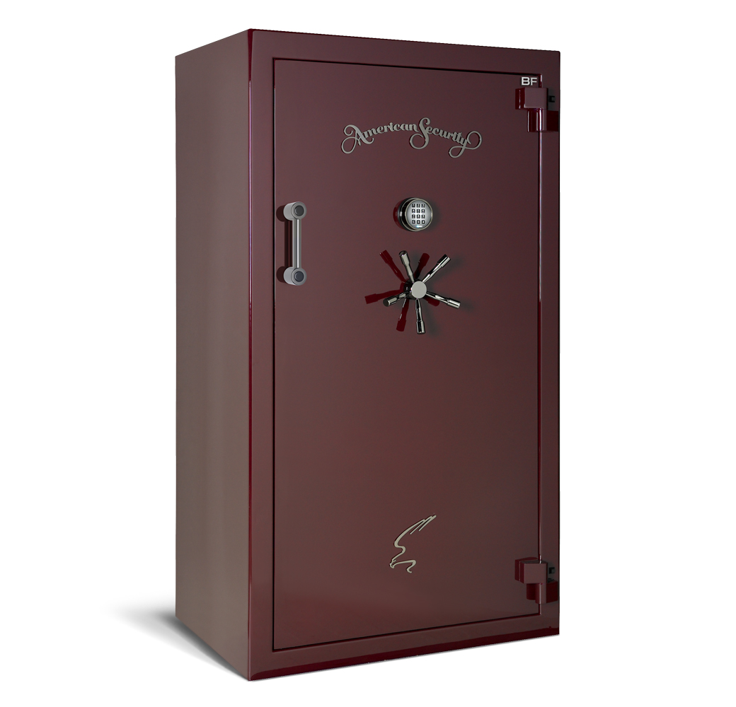
Examples of Safes

Slide 14
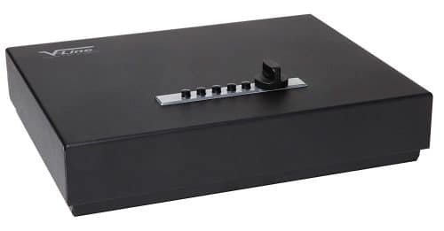
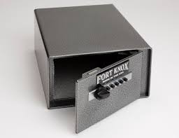
Examples of Lockboxes

Slide 15
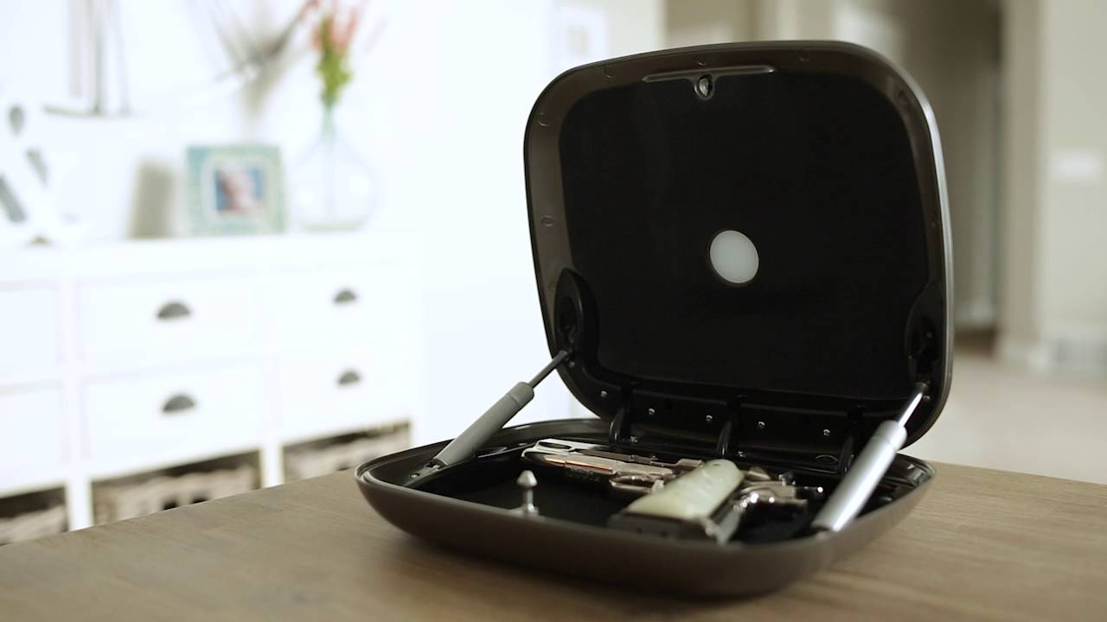
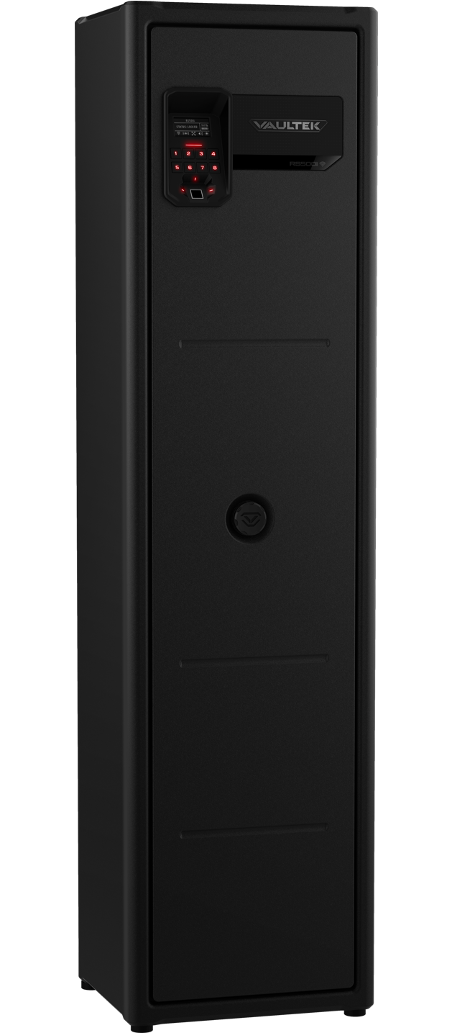
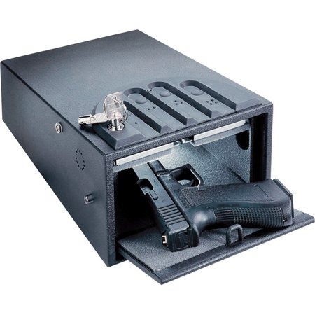
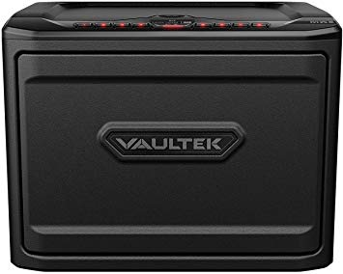
Examples of Quick Access Lock Boxes

Slide 16
Lost Firearms
Must report make, model, and serial number to law enforcement within 5 days from knowing or reasonably should have known of the theft. (Prop 63, CA Penal Code 25265, 25270.)
First Offense: $100
Second Offense: $1,000
Third Offense: Misdemeanor and $1,000

Slide 17
Senior Citizens Living in Assisted Living
Keep Our Seniors Safe Act (SB172)
Initially meant to prohibit firearm access from seniors who have mild to severe cognitive impairment.
In reality, ANY person who plans to live in assisted living facility with firearms must:
(1) Determine whether facility permits firearms on property, and
(2) Surrender all firearms and ammunition to facility to be stored in a centrally located gun safe.
(3) No assault weapons! (This is a very big deal for many firearms owners.)

Slide 18
Concealment & Transportation of Firearms
Illegal Concealment: (1) Capable of being concealed and in car without being locked up; (2) Capable of being concealed and carrying on person. (CA Penal Code 25400.)
Illegal Open Carry: Cannot carry open and loaded or loaded in public. (CA Penal Code 26350.) Passed in 2012.
Legal Concealment: Concealed weapons permit. (CA Penal Code 25655, 26150.)
Legal Transportation: Unloaded and kept in locked container. (CA Penal Code 25505.) Fully enclosed and locked by padlock, key lock, combination lock, trunk of motor vehicle but not utility or glove compartment. (CA Penal Code 16850.)
There are many exceptions to these rules (too many to list) but most apply to law enforcement.

Slide 19
Identification of the Specific Firearm in Question is Critical
Not every firearm is the same and the law scrutinizes different types and configurations.
Types of Firearms:
Single Shot Pistol
Semi-Automatic Pistols
Single Shot Rifle (Bolt-Action)
Semi-Automatic Rifles

Slide 20
Identification of the Specific Firearm Continued
Curios and Relics: Special interest to collectors not associated with sporting, offensive or defensive weapons, manufactured at least 50 years prior to current date; Certified by curator of museum; Novel, rare bizarre, historical. (27 CFR 478.11.)
Antiques: Any firearm manufactured before January 1, 1899, or any firearm not designed or redesigned for using rimfire or center fire ignition with fixed ammunition and manufactured in or before 1898, or any firearm what uses rimfire or centerfire ammunition but where ammunition is no longer manufactured and is not readily available in ordinary channels of commerce. (CA Penal Code. 16170.)
“Generally Prohibited Weapons:” Includes cane gun, unrecognizable firearm, large-capacity magazine, multiburst trigger activator, short-barreled rifle, short-barreled shotgun, wallet gun, zip gun, machine guns, silencers. (CA Penal Code 16590, 32310, 32625, 33410, 33600.)

Slide 21
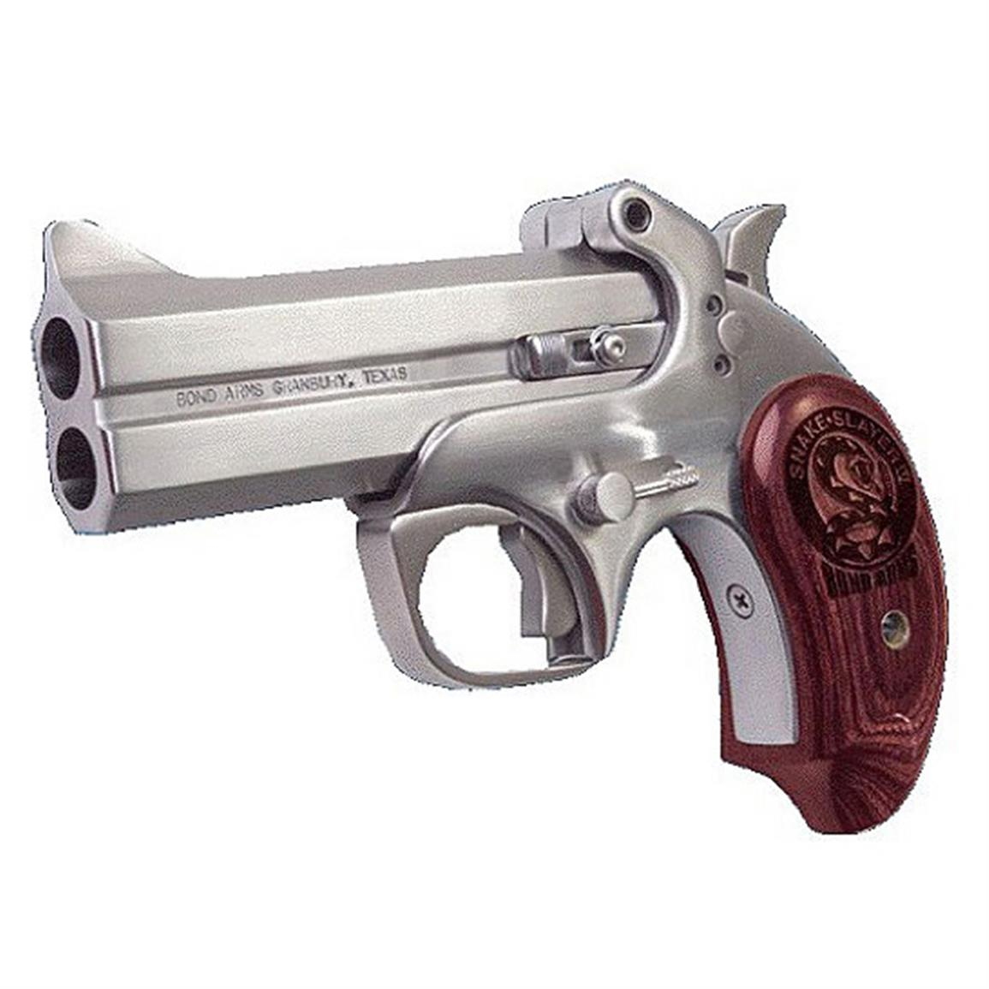
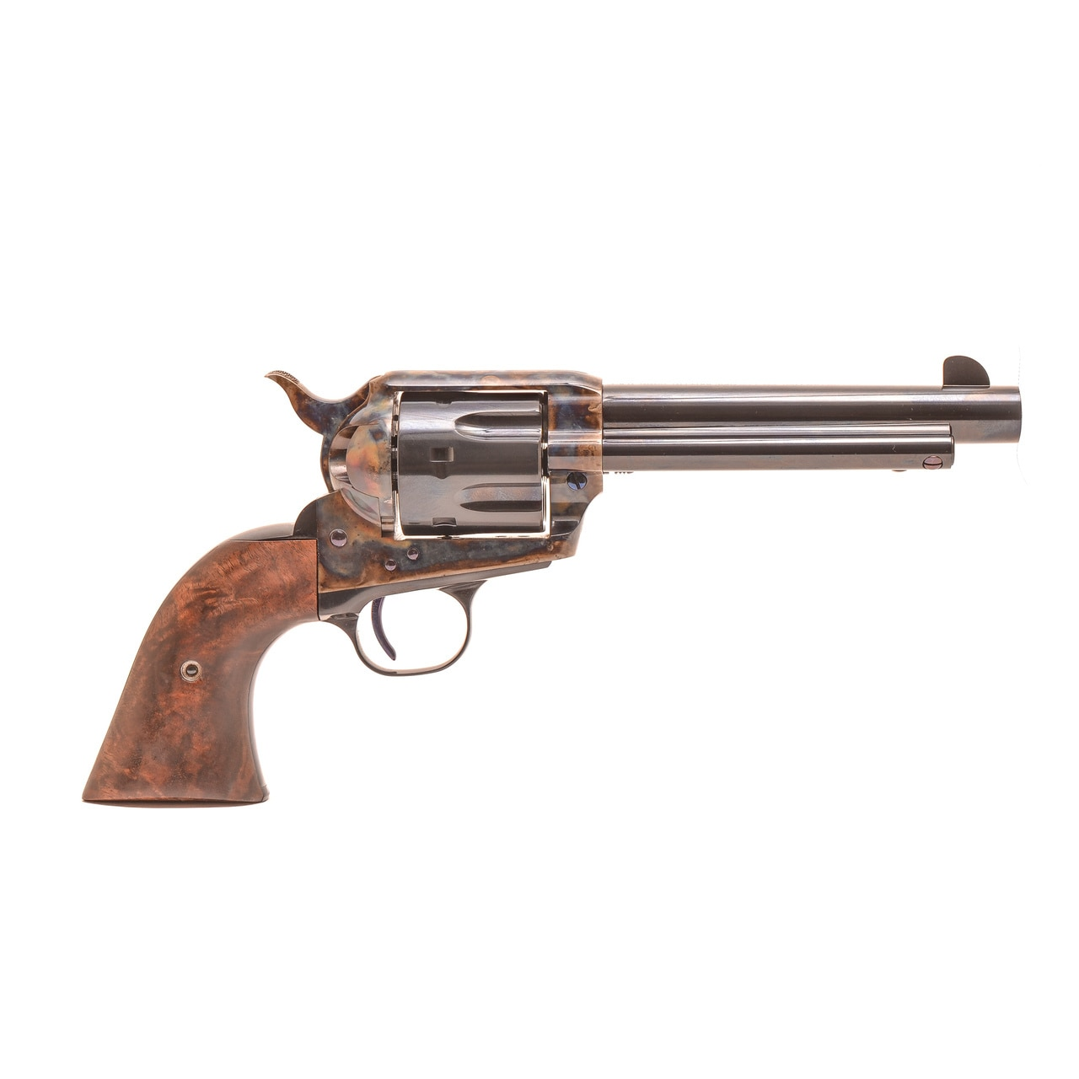
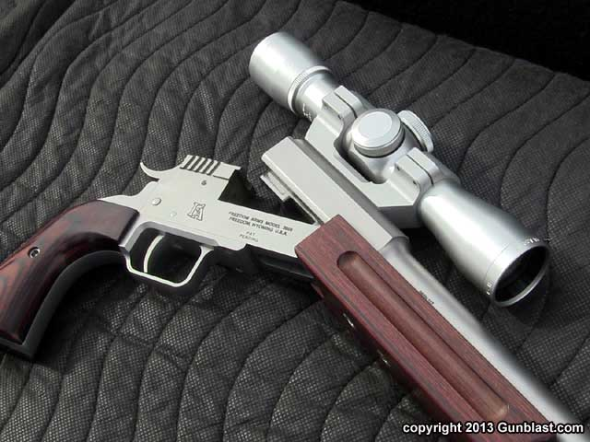
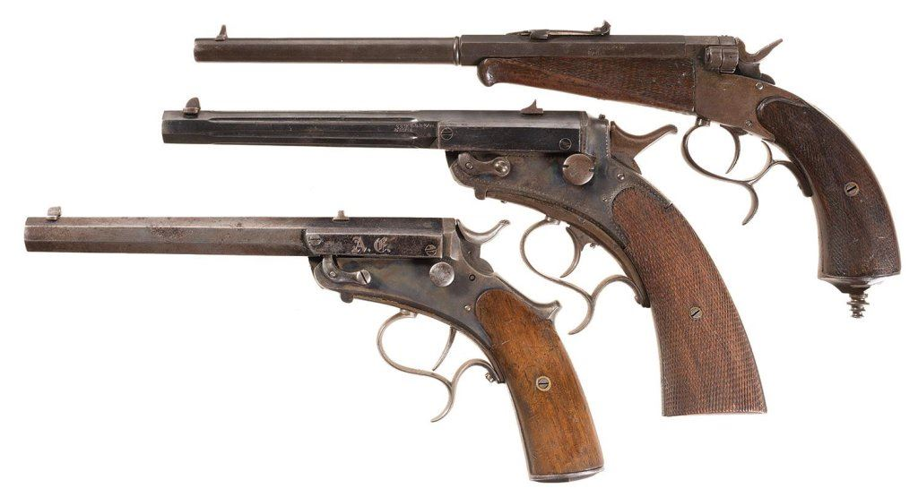
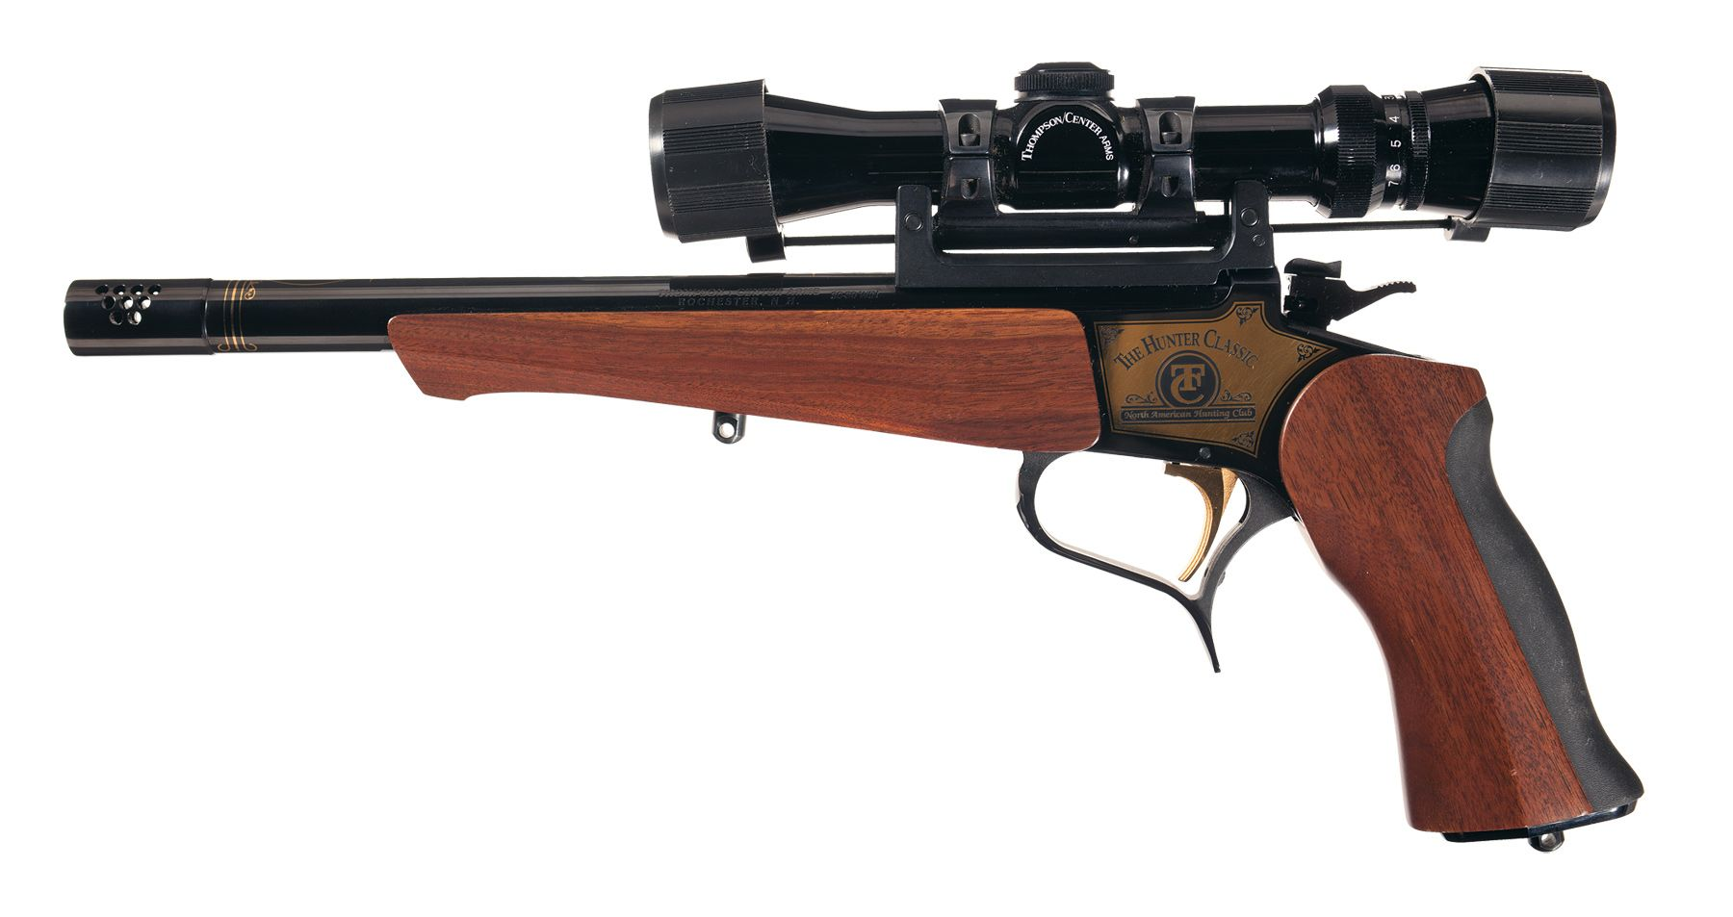
Examples of Single Shot Pistols

Slide 22
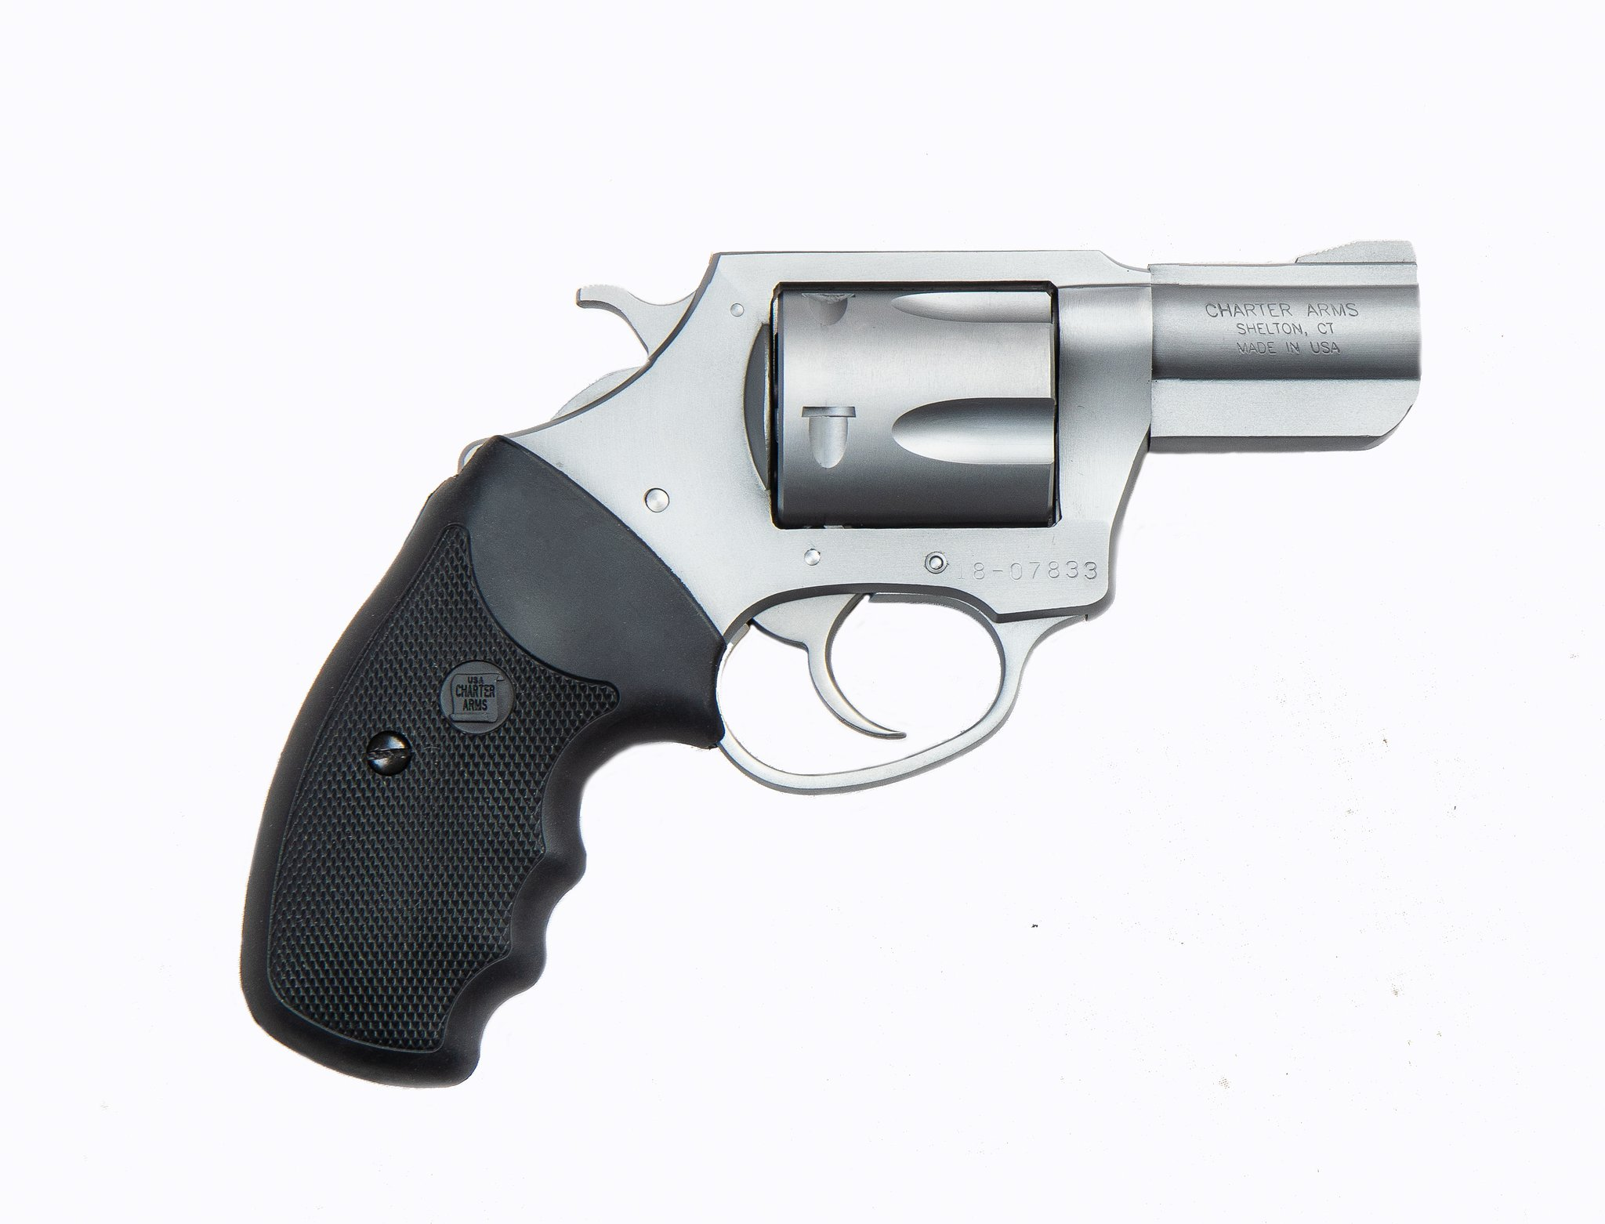
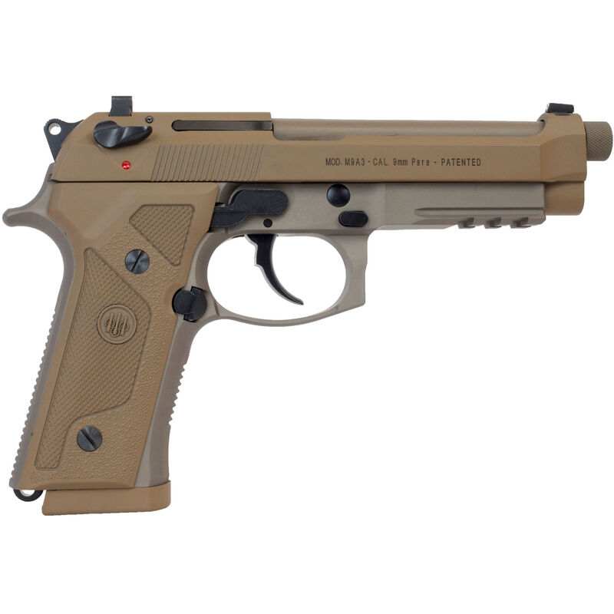
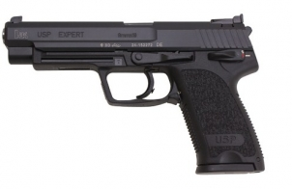
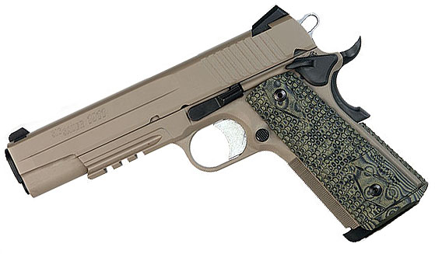
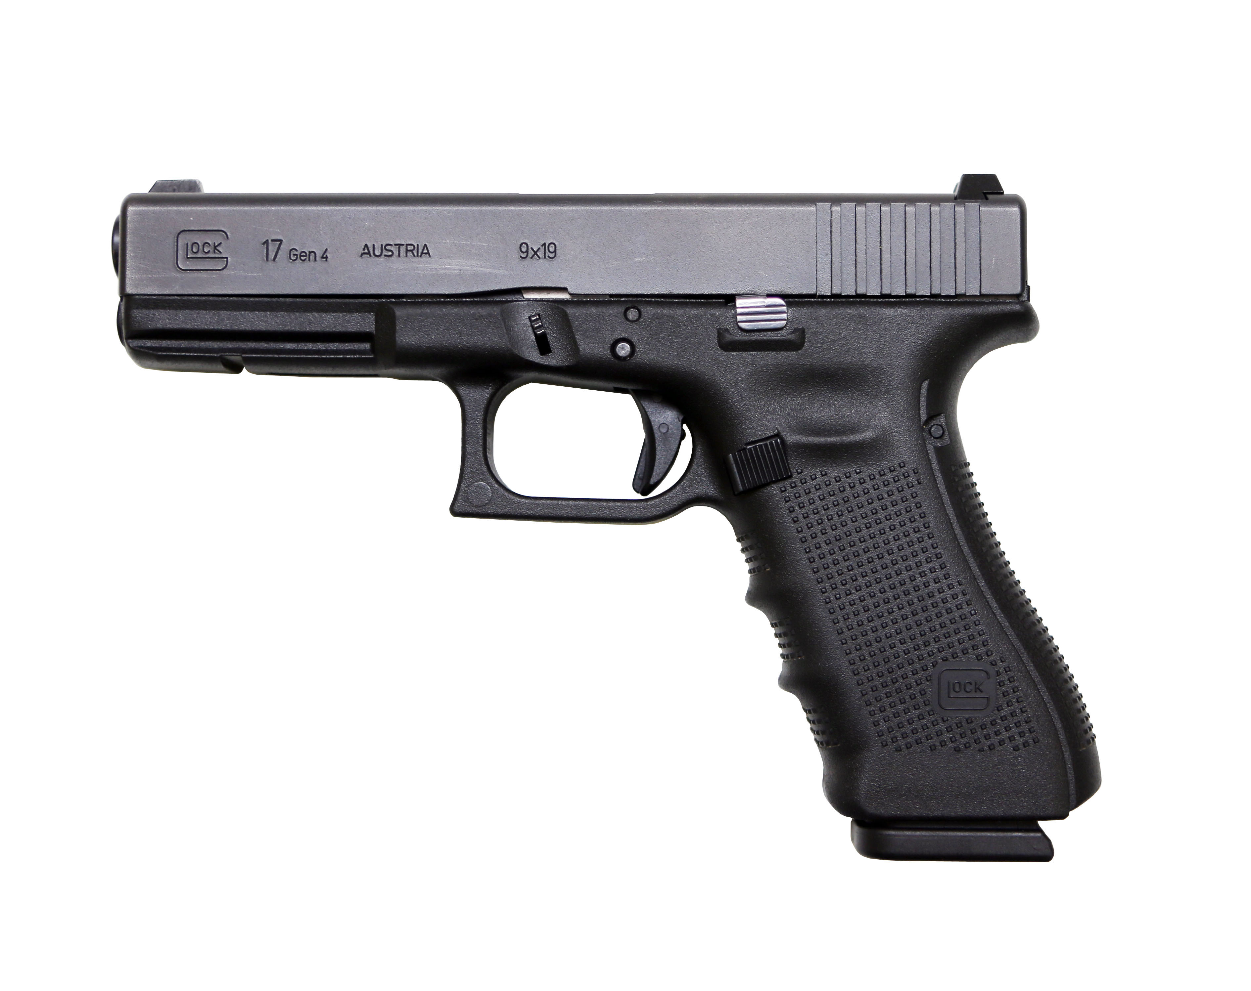
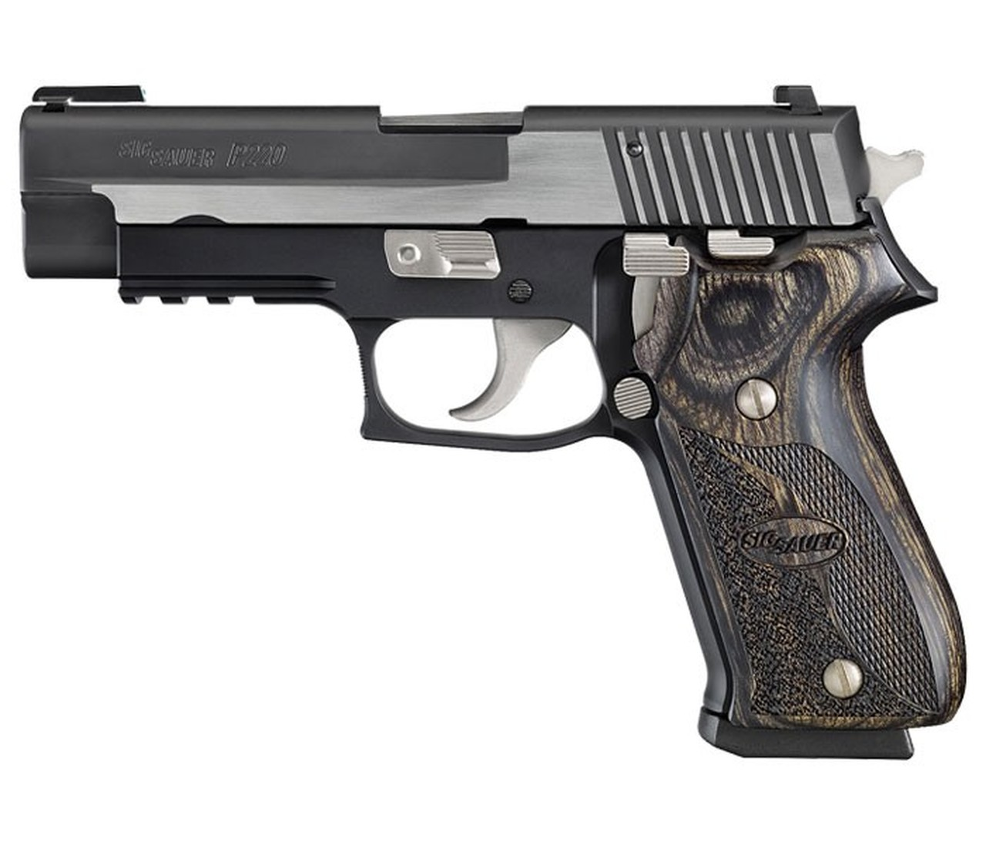
Examples of Semi-Automatic Pistols

Slide 23
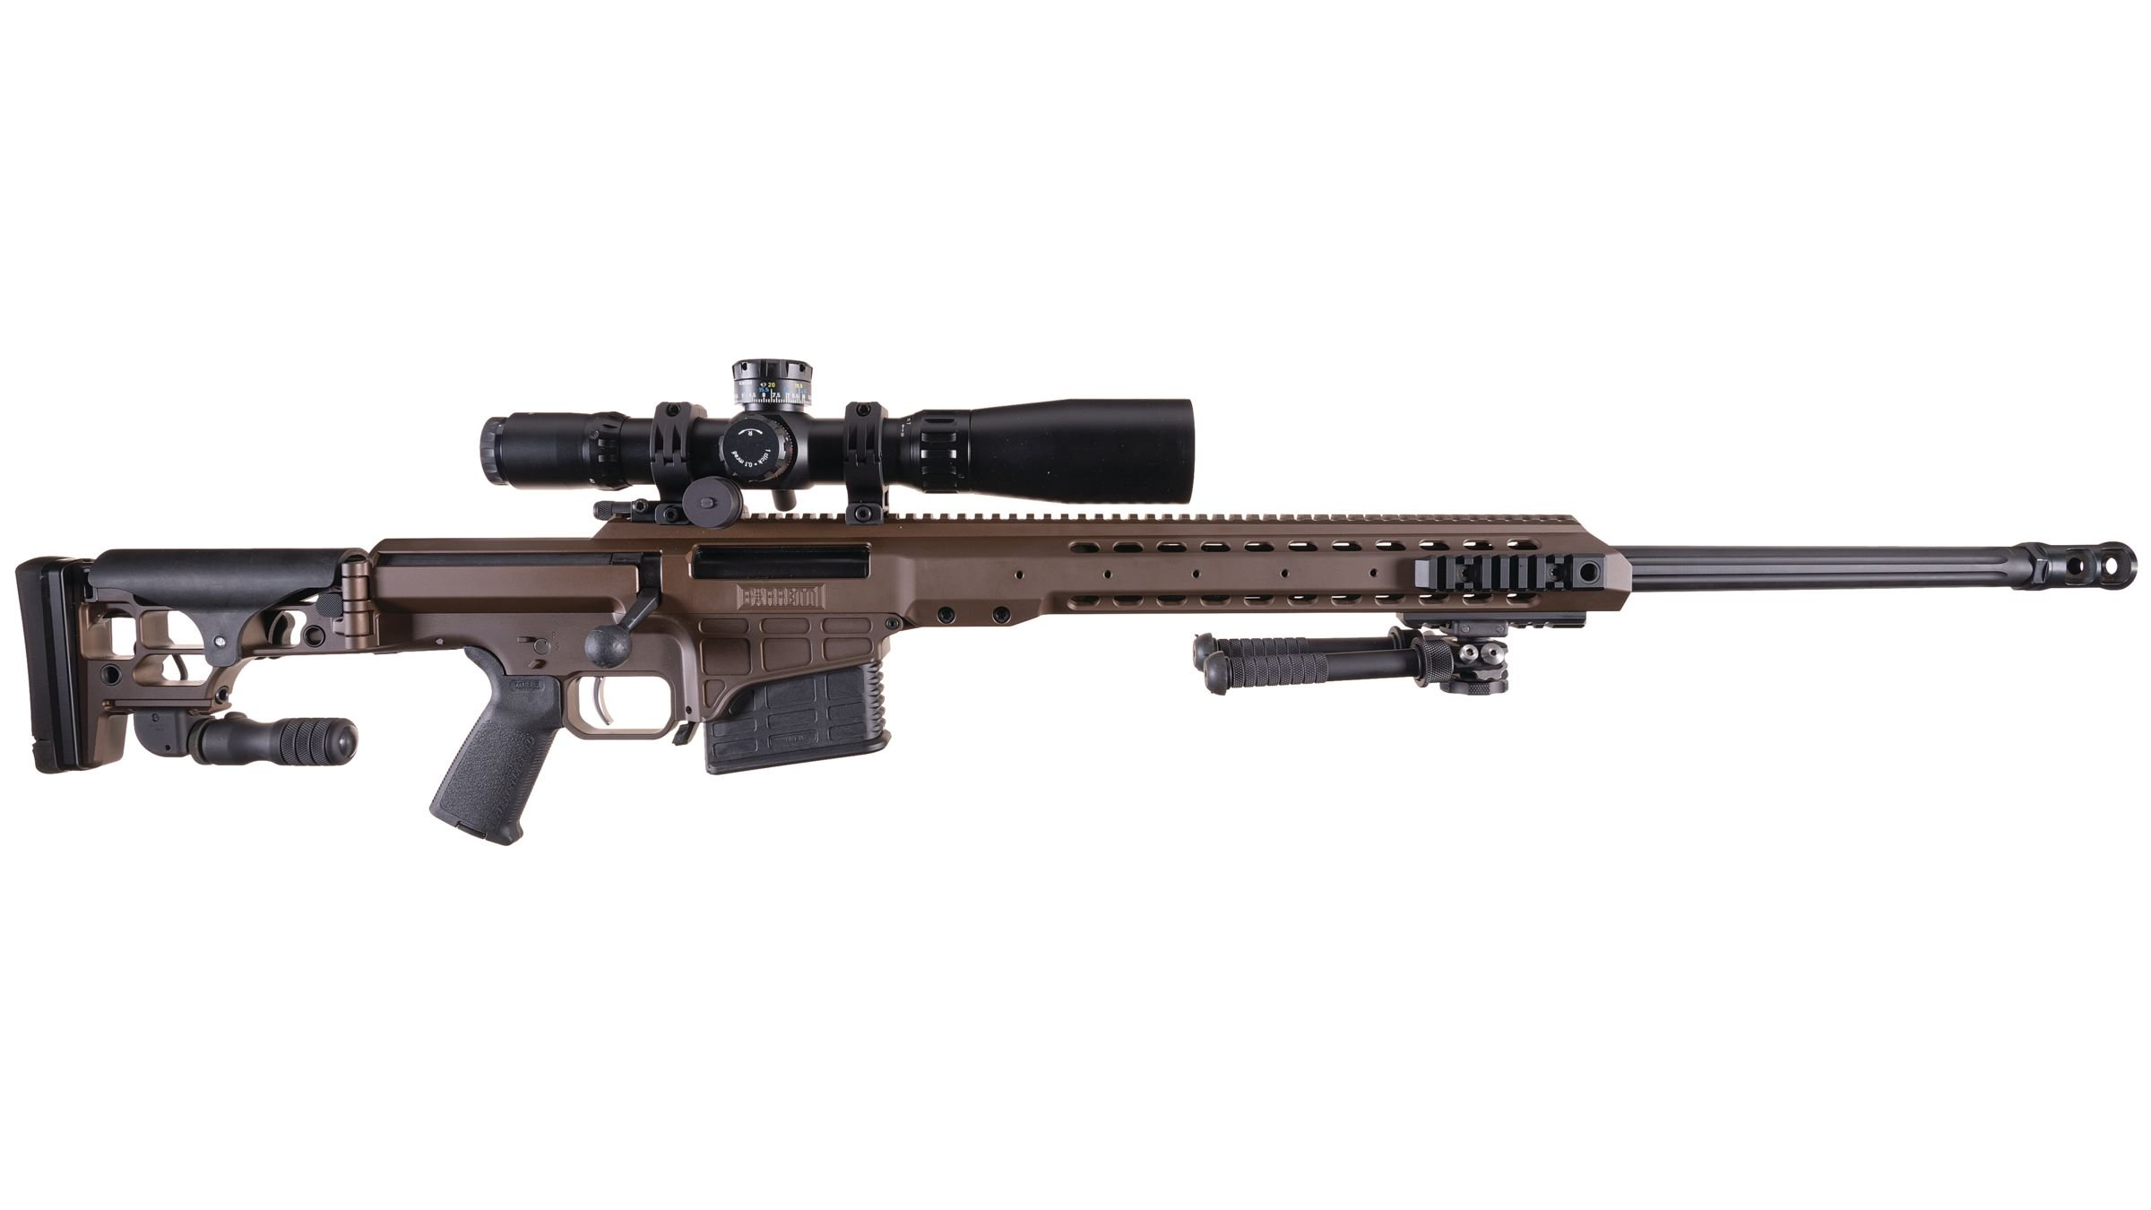
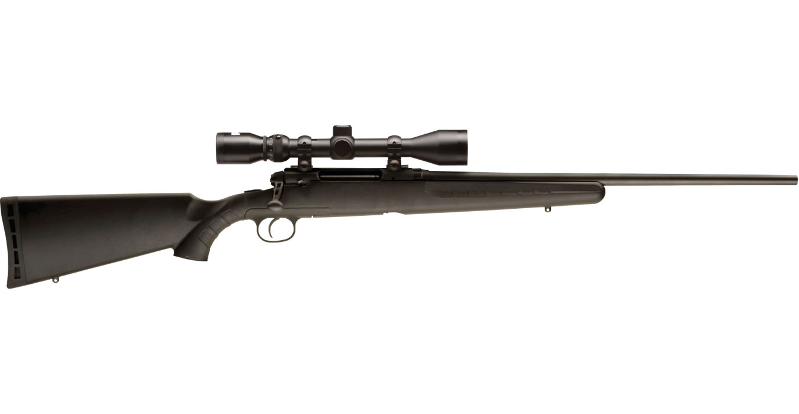
Examples of Single Shot Rifles

Slide 24
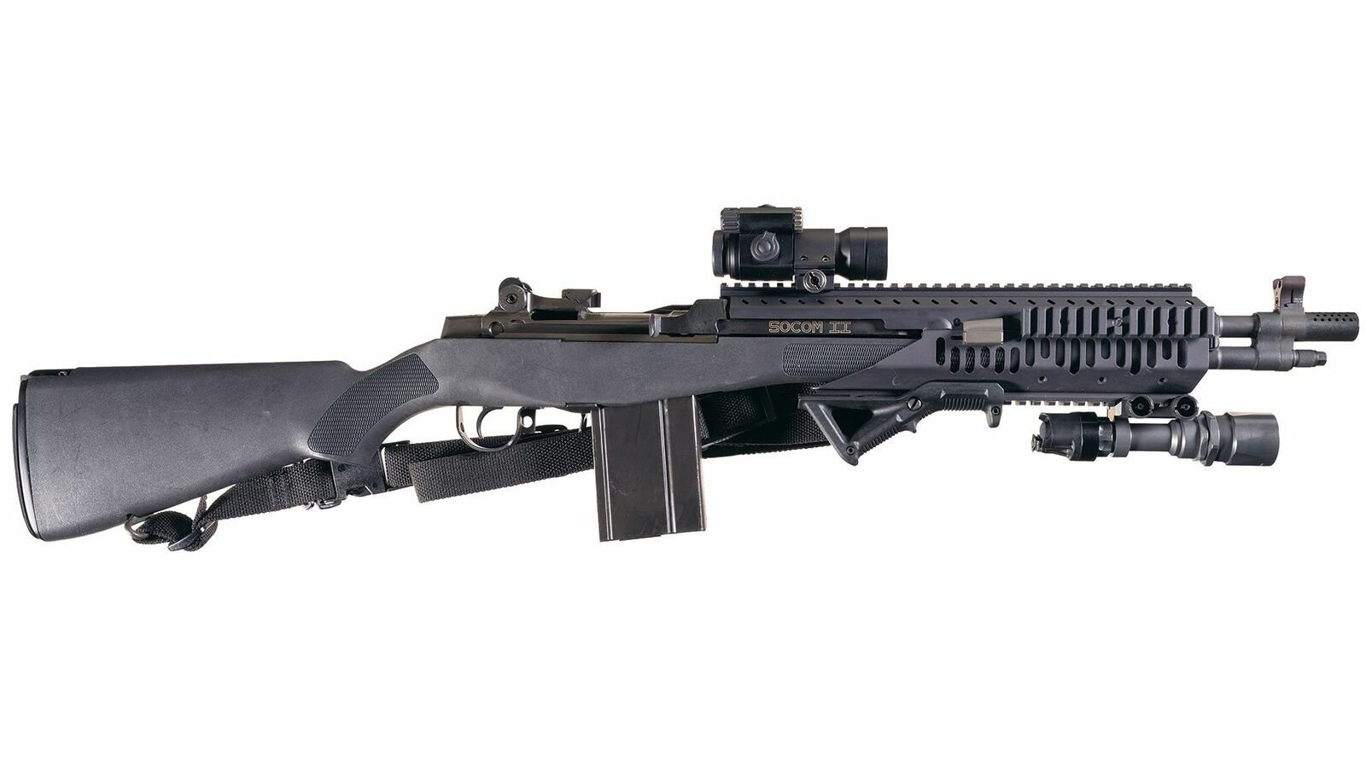
Examples of Non-Assault Weapon Semi-Automatic Rifles

Slide 25
Transfer of Firearms
All parties to the transaction shall complete the sale, loan, or transfer of that firearm through a licensed firearms dealer (FFL). (CA Penal Code 27545.)
No firearm shall be delivered by a FFL within 10 days of the application to purchase. (CA Penal Code 27540, 26815.)
Exceptions:
Government Entity: (1) Authorized representative takes possession, (2) Voluntary program for acquiring weapons. (CA Penal Code 27850.)
Museums or Historical Societies: (1) LEO is donor, (2) Open to public, (3) Firearm deactivated, (4) not an NFA firearm or assault weapon (generally), (4) Report to DOJ. (CA Penal Code 27855, 27860.)
Gift, Bequest, Intestate Succession: (1) Infrequent (less than 6 pistols, “without regularity” for all other types), (2) Between members of immediate family (parent to child, grandparent to grandchild, spouse to spouse), (3) Report to DOJ within 30 days, (4) Must have FSC. (CA Penal Code 27875.) Same for interstate transfer (gun coming into state).

Slide 26
Transfer of Firearms Continued
Loan to Family Member: (1) Parent, child, sibling, grandparent, grandchild, (2) “Infrequent,” (3) NTE 30 days, (4) Must have FSC. (CA Penal Code 27880.)
Loan to Everyone Else: (1) In presence of firearm at all times, (2) Lawful purpose, (3) 3 day duration. (CA Penal Code 27885.)
Loan at Shooting Range. (CA Penal Code 27910.)
Gunsmith: Repairs to firearm. (CA Penal Code 27890.)
Sale at Auction by Non-Profit or Public Benefit Corp. (CA Penal Code 27900.)
In State Transfer to Executor or Administrator: (1) Must report to DOJ within 30 days, (2) State how firearms was obtained, (3) Description of firearm. (CA Penal Code 27920, 16990, 31700.)
In State Transfer to Trustee: All same as Executor or Administration except, (4) Must obtain an FSC. (CA Penal Code 27920.)
Curio or Relics: (1) Not handgun, (2) “Infrequent,” (3) Licensed collector, (4) Report to DOJ parties to the transaction, how firearms was obtained, and description. (CA Penal Code 27966.)

Slide 27
National Firearms Act of 1934
Originally designed to impose tax ($200) on making and transfer of firearms, and create a registry for those firearms defined within the Act (i.e. “NFA Firearms”). Back then a $200 tax was considered prohibitory.
NFA Firearms
Shotguns with barrels less than 18 inches or OAL of less than 26 inches.
Machine Guns
Mufflers or Silencers (i.e. Suppressors)
AOW (Any Other Weapon): Zip gun, wallet gun, cane gun pen gun, cell phone gun, smooth bore shot-gun pistols.

Slide 28
NFA Constitutionality
Deemed unconstitutional by Haynes v. United States, 390 U.S. 85 (1968) due to forced registration compelling people to self-incriminate.
Not to worry! The Gun Control Act of 1968 (“GCA”) removed the registration requirement for those already in possession of NFA Firearms thus preserving the NFA law.

Slide 29
Can Californians Possess NFA Firearms?
NO! (Subject to very limited circumstances that do not apply to ordinary citizens of the state.)
In order to possess NFA Firearms you must be a LEO, or have a Dangerous Weapons Permit. (CA Penal Code 12020, 32650.) The test for good cause is “necessity.” This permit is virtually never granted.

Slide 30
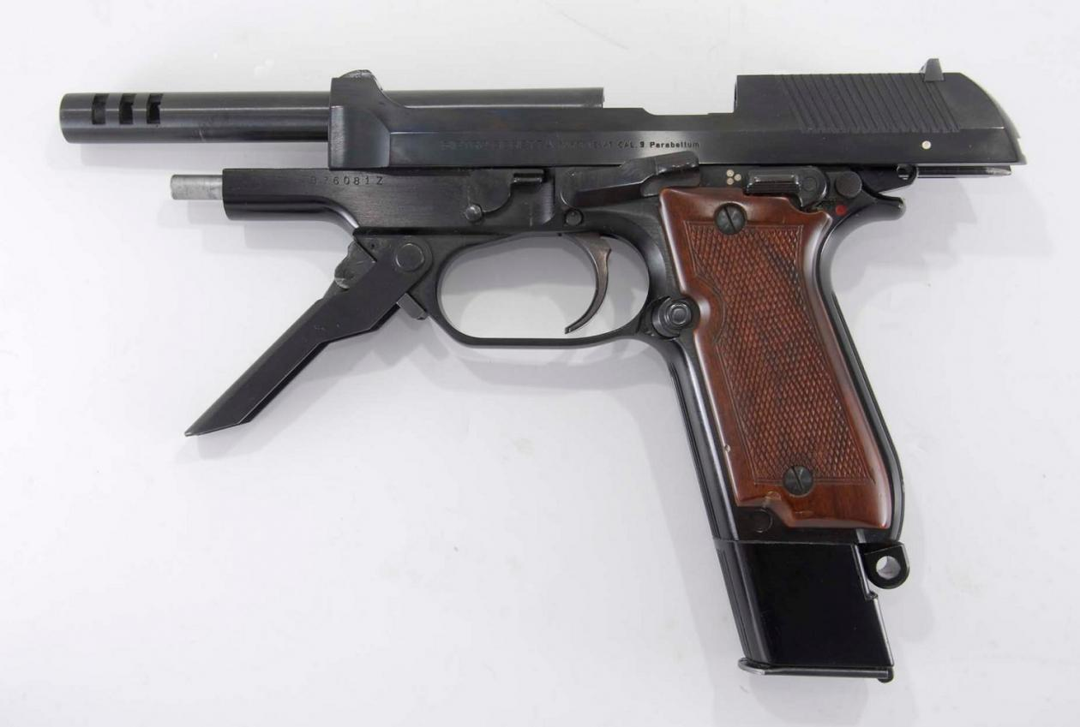
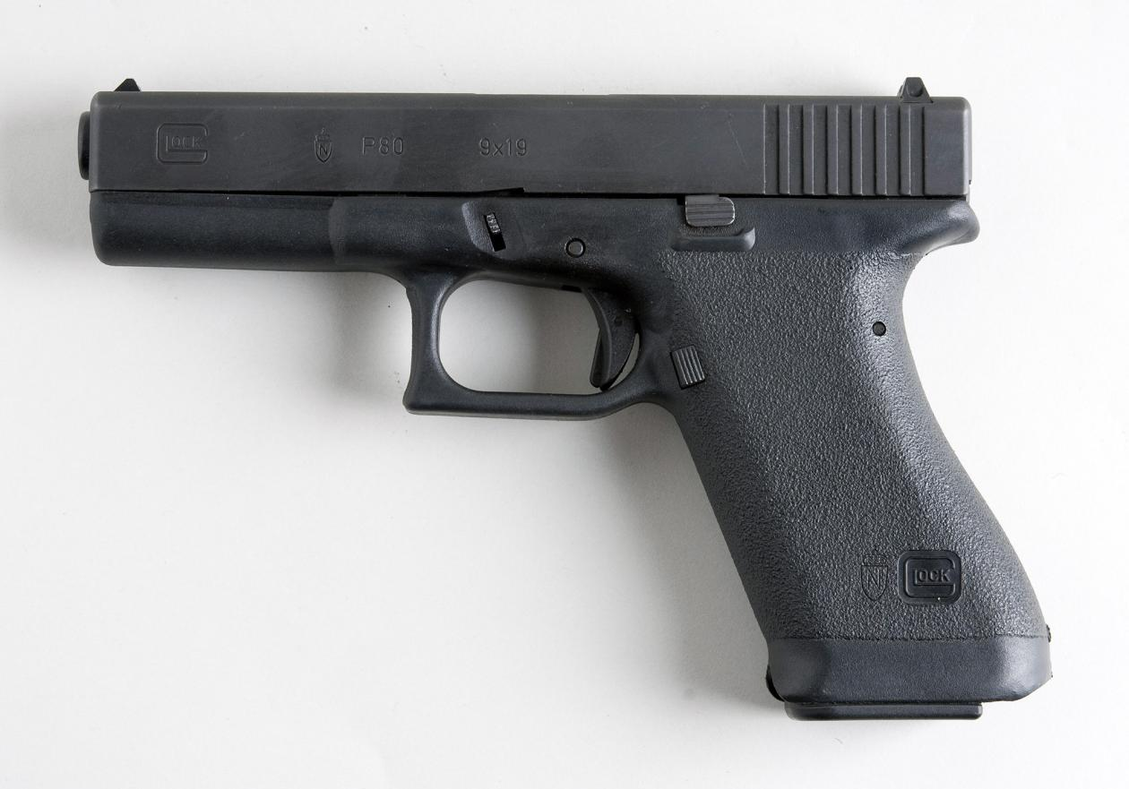
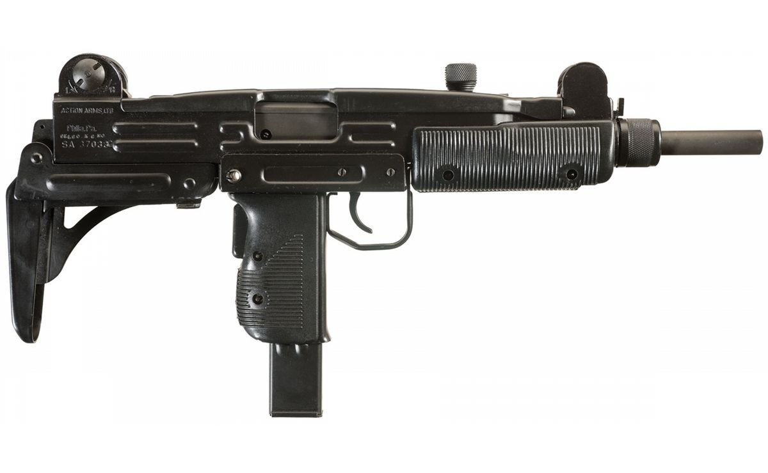
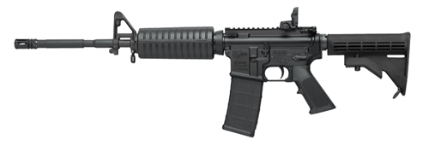
Examples of Machine Guns

Slide 31
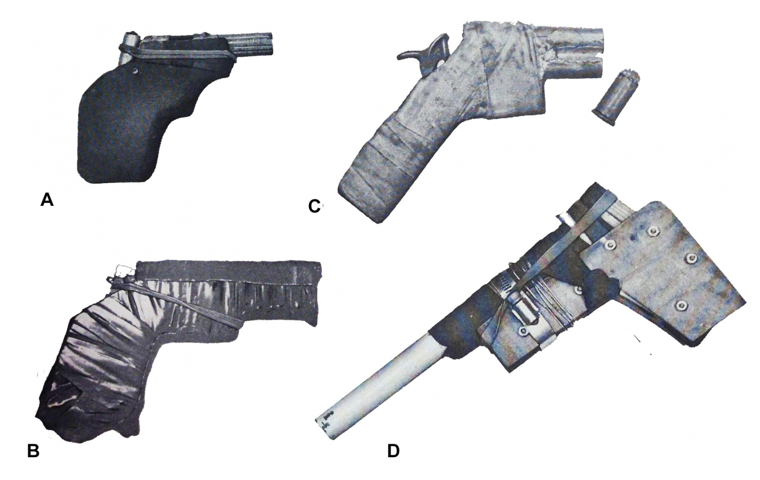
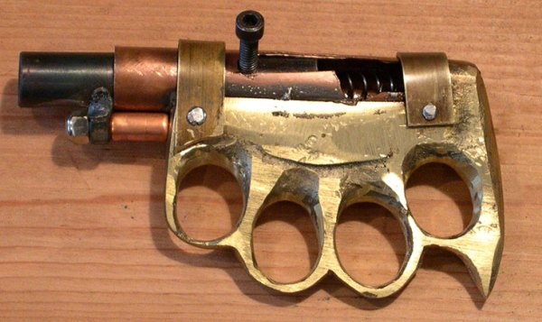
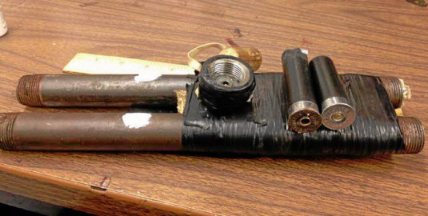
Examples of Zip Guns

Slide 32
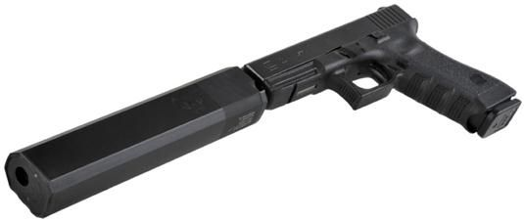
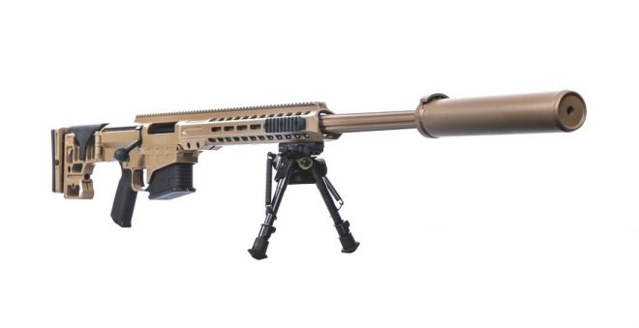
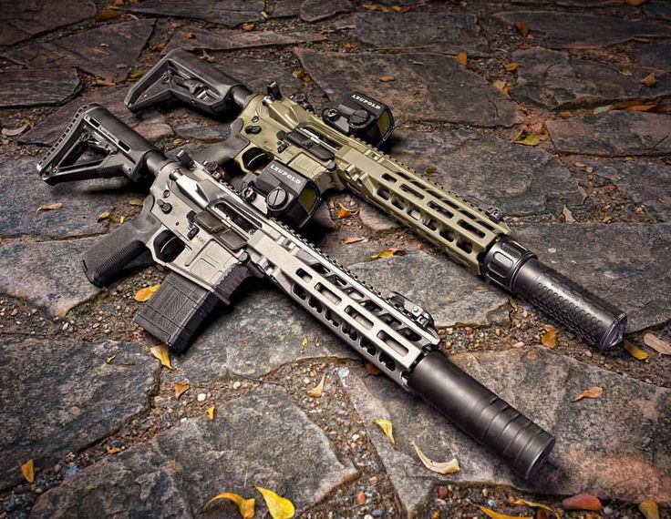
Examples of Suppressors (Silencers)

Slide 33
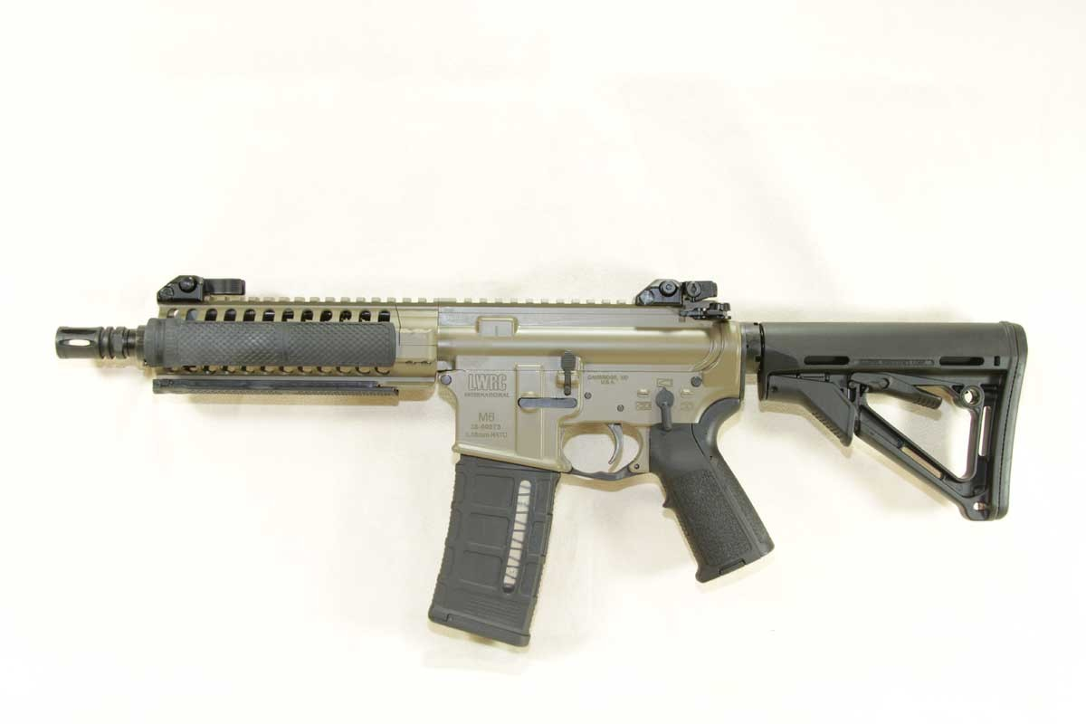
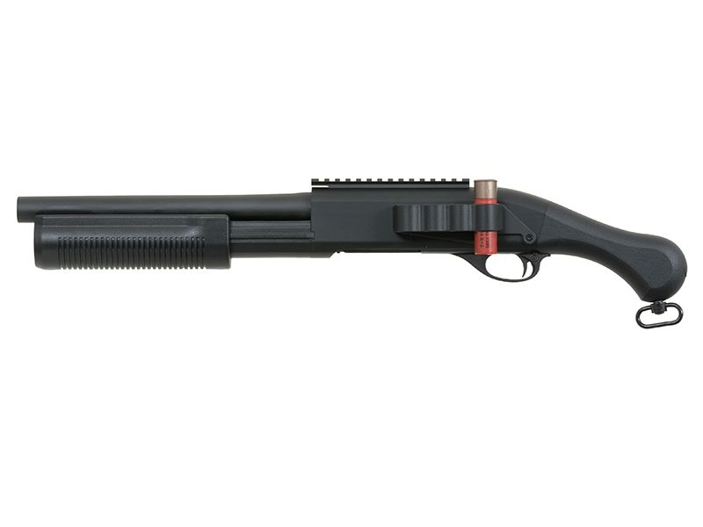
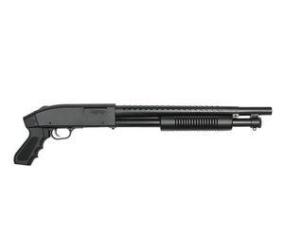
Short Barreled Rifles and Shotguns

Slide 34
Can Californians Purchase or Possess “Assault Weapons?”
NO! & YES! (Both subject to very narrow exceptions). You can possess assault weapons if they were registered before the cutoff date. You can buy assault weapons only if you are issued a Dangerous Weapons Permit.
Assault Weapons Control Act of 1989 (Roberti-Roos) (CA Penal Code 30510.)
Category I: Specifically listed firearms on the original ban list (make and model). Registration Concluded January 1, 1991. (CA Penal Code 30900.)
Category II: Specifically listed AR-15 and AK-47 series weapons (make and model). Registration Concluded January 1, 2001. (CA Penal Code 30900.)

Slide 35
Category III Assault Weapons (CA Penal Code 30515)
This is where it gets tricky! Why? Because many commonly owned rifles purchased legally in California are now Assault Rifles.
Litmus Test for Rifles:
Semi-Automatic, Centerfire, Detachable magazine AND any of the following (“evil features”): Pistol grip, Thumbhole stock, Grenade Launcher, Flash Suppressor, Forward pistol grip.
Semi-Automatic, Centerfire, Fixed magazine accepting more than 10 rounds.
Semi-Automatic, Centerfire, rifle with OAL less than 30 inches.

Slide 36
Detachable Magazine
This is the critical feature that makes the firearm an “assault rifle.”
Detachable:
If the magazine can be ejected without the use of a tool it is an assault rifle. Registration concluded on January 1, 2001. (CA Penal Code 30900.)
If the magazine can be ejected with the use of a tool it is an assault rifle. Registration concluded on July 1, 2018. (CA Penal Code 30900, SB880/AB1135.)
In order to not fall under the feature definition the user of the firearm must disassemble the firearm action.

Slide 37
Ambiguity in Detachable Magazine Statute
There is some unresolved confusion in the law: The law states in part, “any person who from January 1, 2001 to December 31, 2016 lawfully possessed an assault weapon…including those weapons with an ammunition feeding device that can be readily removed from the firearm with the use of a tool, shall register…”
However, the DOJ has treated conversion of a rifle to not have a “detachable magazine” as though it is permissible.

Slide 38
Assault Weapons & .50 Cal Rifle Transferabilty
Generally cannot transfer and must be registered. (CA Penal Code 30900.)
Exception is if Curio or Relic or receives a Dangerous Weapons Permit. (CA Penal code 31005.)
If heir receives a firearm that falls into the assault weapon or .50 Cal Rifle category, within 90 days they must: Render weapon permanently inoperable; (2) Sell to FFL; (3) Obtain permit from DOJ, remove from state. (CA Penal Code 30915.)
This does not mean you can possess the firearm in the meantime unless you are an Executor or Administrator (No Trustee exemption!) (CA Penal Code 30655.)

Slide 39
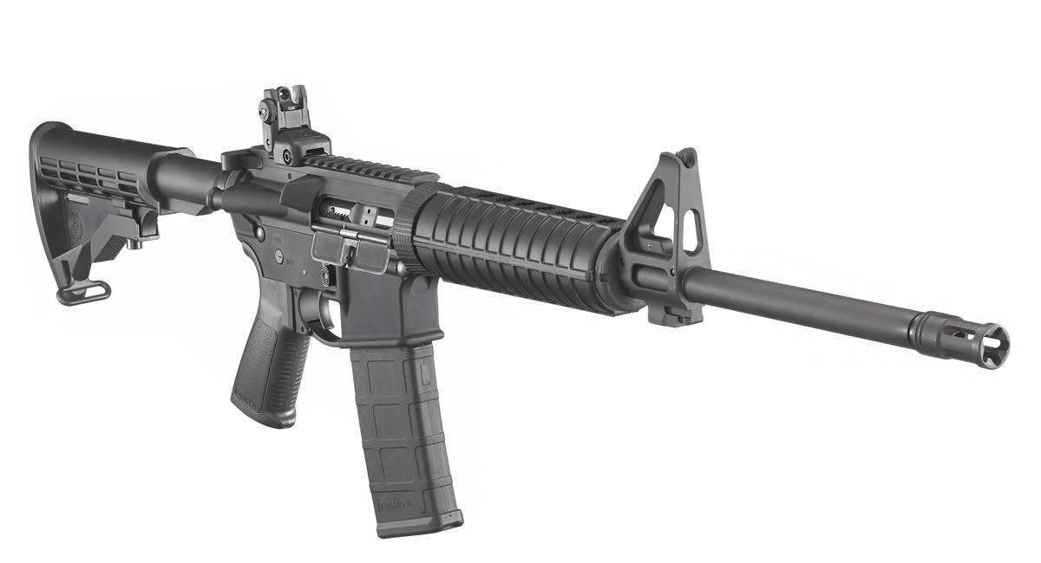
Examples of Assault Rifles

Slide 40
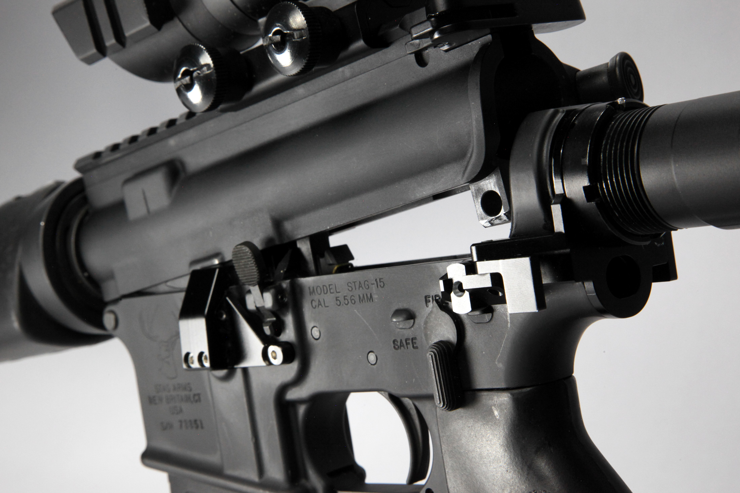
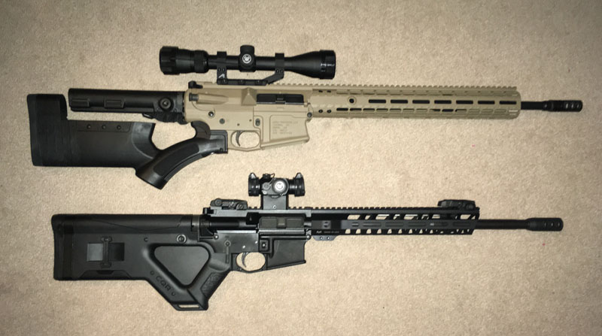
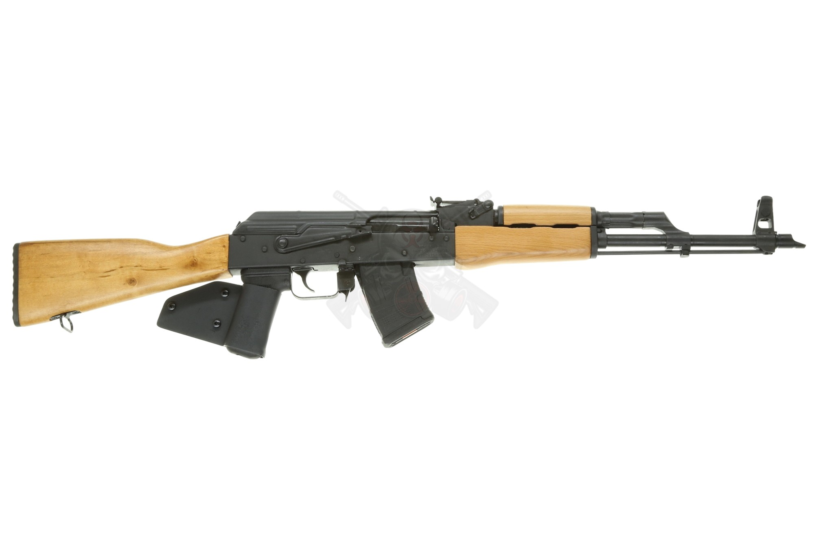
Examples of Rifles That Do Not Meet Category III Description

Slide 41
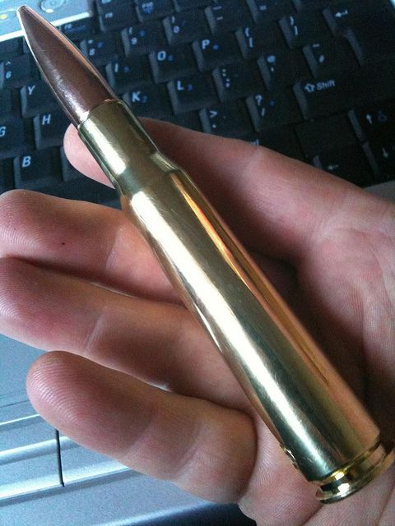
Examples of .50 Cal Rifles

Slide 42
The Gun Trust Myth in California?
Prevents firearms from becoming public record. True.
Avoids probate. True, but possession of assault weapons by Trustee is illegal, and transfer is illegal unless recipient has DWP.
Easier to challenge distribution of probate property than to challenge distribution of trust assets. True.
Designed from the ground up by “an experienced gun trust attorney” to address specific issues related to use, possession, and transfer of firearms. Not really. There is no “secret sauce” to bypass CA law on these issues.
Designed to hold NFA firearms. NOT TRUE! Cannot bypass CA with a trust.
Can appoint additional co-trustees at any time so they can use and possess your firearms. Not true with the intent because this doesn’t bypass any possessory or transfer laws instituted by CA.

Slide 43
Theory Behind Gun Trust
Settlor declares he holds NFA Firearms or assault weapons in a trust.
The declaration in trust does not constitute a transfer to a trust and skirts the no-transfer policy.
The settlor could select co-trustees and then grant them access to firearms without need for the recipient to obtain a DWP.
This is an untested theory likely to be determined an improper circumvention of the DWP requirement because CA law does not support this process.
CA treats a trust not as a person but rather as a fiduciary relationship with respect to property. Logically, a trust may not obtain a DWP separate from one obtained by the possessor, and the recipient cannot act under the possessor’s DWP.
Legal entities also cannot possess DWP permits.

Slide 44
If You Have a Gun in a Trust, Be Sure to Review the Trust Every Year
Every year new gun laws are passed that further restrict the types of firearms CA citizens can possess. Even guns bought legally in CA will become illegal from possession or transfer to an heir or one who failed to register their newly minted illegal firearm.
It follows that guns identified in a trust may become non-transferrable as new laws are passed.

Slide 45
Recommendations for Transfer
Transfer possession of firearms prior to ban during the life of owner.
Transfer banned firearms out of state, e.g., Arizona.
Convert all banned firearms to fall within the definition of non-assault weapon descriptions.
Keep in mind this is a gray area and technically illegal under the statute for purposes of avoiding assault weapon registration and allowing transfer.

Slide 46
Future Restrictions
CA is ALWAYS enacting new firearms restrictions, and now ammunition restrictions. It is important that we review the new restrictions and refresh our memories of current law.
AB879: On July 1, 2024, “precursor parts” cannot be sold without the use of an FFL. This means 10 day waiting period and only one part every 30 days.
Precursor Parts: Component of firearm that is necessary to build or assemble a firearm, including: Unfinished receiver (single part or multiple part receiver), the receiver tube, unfinished handgun frame. Does this mean take-down pins, triggers? Unclear.
SB61: Will now restrict semi-automatic centerfire rifle purchases to every thirty days (this already applies to handguns).

